Slide 1
Group tasks
Task 1: work in groups and discuss the following questions and at least one student will be invited to present each group’s opinion.
What’s your opinion on homosexuality?
Can you accept the same sex marriage?
Task 2: work in groups and discuss the answers of the five questions before the passage in unit 5. Each group will be invited to answer at least one question.

Slide 2
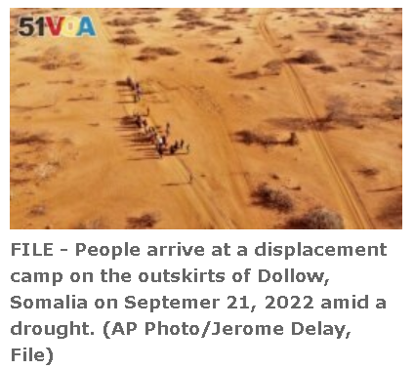
Report: 43,000 Estimated Dead in Somalia Drought Last Year
By Gregory Stachel
26 March 2023

Slide 3
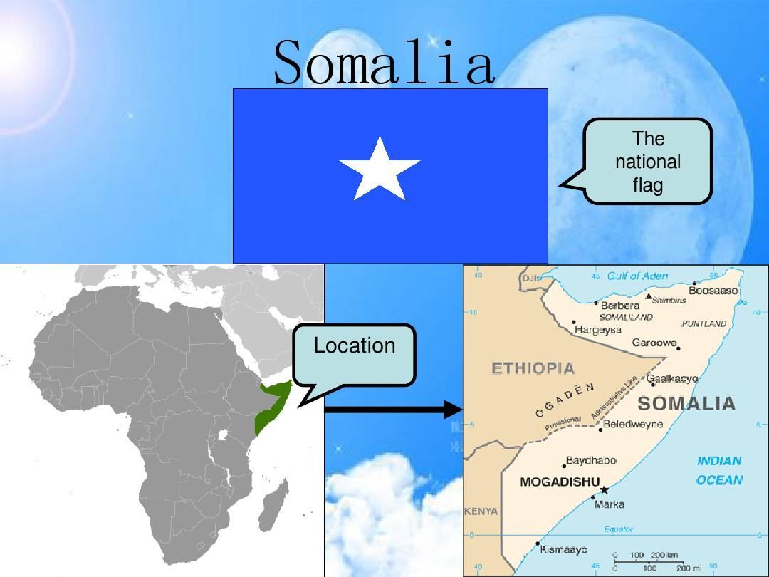

Slide 4
Who?
What?
Why?
Where?
When?

Slide 5
A new report says an estimated 43,000 people died during Somalia's longest drought on record last year. Half of them were likely children under five years old.
It is the first official count of deaths announced in the drought that is affecting large parts of the Horn of Africa.
At least 18,000 people, and as many as 34,000, are predicted to die in the first six months of this year.

Slide 6
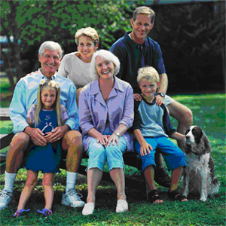
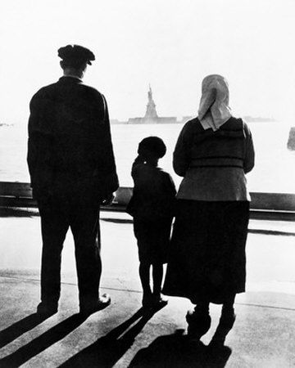
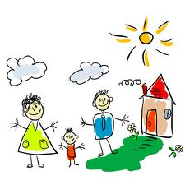
Unit five
Marriage and family life

Slide 7
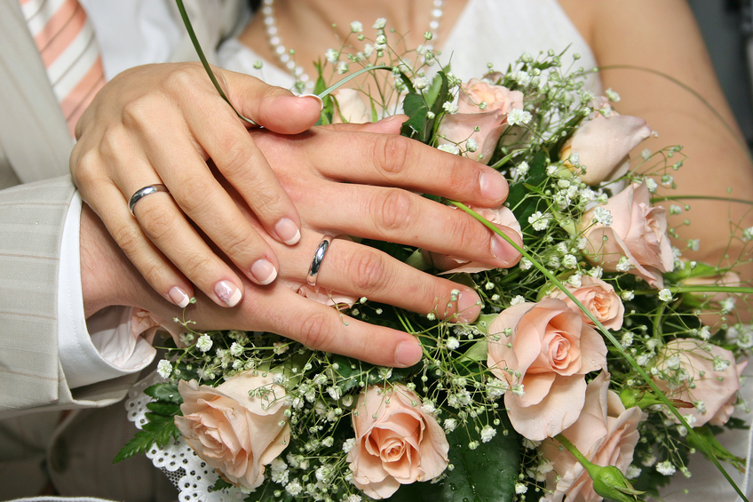
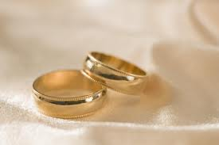
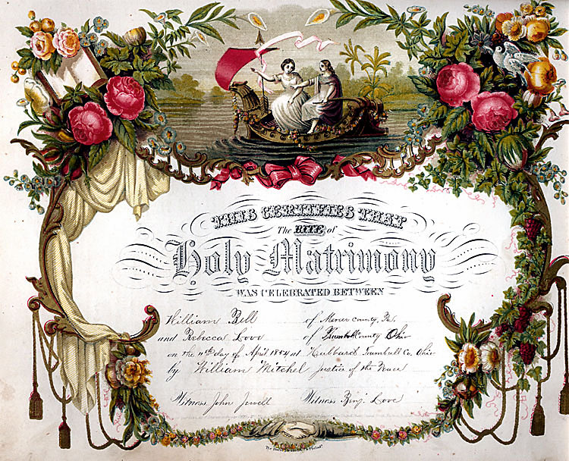
Marriage?

Slide 8
Warm-up Questions
Work in groups and discuss the following questions:
What’s your opinion on homosexuality?
Can you accept the same sex marriage?
2. At least one student will be invited to present each group’s opinion.

Slide 9
Some opinions on homosexuality
(for reference)
Homosexuality is something I will never understand, nor want to.
People should never be judged by their sexual preference, as it is something that is personal. …

Slide 10
I think it's absolutely fine to be gay/lesbian. People are attracted to different people, sometimes men, sometimes women. Just because two men and two women can't make a baby doesn't make their love wrong. And gay marriage does not ruin the purity of marriage. A civil union is not enough for people who want to get married. If a certain religion does not accept gay marriage, they do not have to let gay people marry in their places of worship…

Slide 11
Homework Checking
Write your answers on your notebook.
You can work in groups and discuss the answers.
Each group will be invited to share your answers.

Slide 12
Structure of the news body
Match each part with the heading chosen from the list.

Slide 13
A. The process of the trial
B. Interesting sidelights of the debate
C. Background of the two characters-Blankenhorn & Boies
D. Blankenhorm’s argument on the condition of marriage itself
E. Blankenhorn’s argument on the influence of marriage on children’s well-being
1: 2-4
2: 5-7
3: 8-9
4: 10-11
5: 12-14
Notes:
CEADB

Slide 14
Read the news carefully and complete the tables.
Knowledge
on same-sex
marriage
Opinions on gay marriage
(Para. & line)
Identity
David
Blankenhorn
David
Boies

Slide 15
A. The process of the trial
B. Interesting sidelights of the debate
C. Background of the two characters-Blankenhorn & Boies
D. Blankenhorm’s argument on the condition of marriage itself
E. Blankenhorn’s argument on the influence of marriage on children’s well-being
1: 2-4
2: 5-7
3: 8-9
4: 10-11
5: 12-14
Notes:
Background of the two characters--Blankenhorn & Boies: Para2-4 C
Blankenhorn’s argument on the influence of marriage on children’s well-being: Para5-7 E
The process of the trial: Para.8-9 A
Blankenhorm’s argument on the condition of marriage itself: Para 10-11 D
Interesting sidelights of the debate: Para 12-14 B

Slide 16
Read the news carefully and complete the tables.
Knowledge
on same-sex
marriage
Opinions on gay marriage
(Para. & line)
Identity
President
Advanced
degree in
comparative
labor history
Arguments on well-being of children:
David
Blankenhorn
Argument on the stability
of marriage:
1. Para 5, line 2
2. Para. 5 line 4
3. Para. 7 line 1
Para. 10. line 2
A lawyer
Majored in law.
Tried to be an
informed
person
Argument on Blankenhorn’s testimony
David
Boies
Para.12 line 2

Slide 17
Reading Activities
Read the headline of the following article and suggest questions you want answered in the article, and then write down the questions in the space below.
Skim through the article quickly and find the answers to the questions you have written down above.
Five questions?

Slide 18
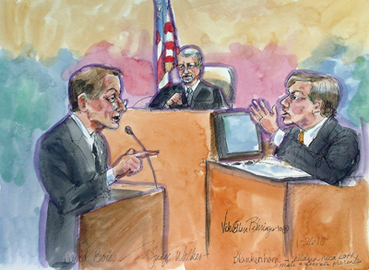
Read the headline
who
what
Witness Says Gay Marriage Would Help Children
Who is the witness?
What is his opinion?
Why did he say so?
Notes:
Sub-headline: The headline and sub-headlines alone should provide a brief summary of news report. Use sub-headlines to deliver a brief version of the news article to scanners who don’t have time to read the body.
Sub-headlines call attention to the article that might not otherwise be read. Readers may be attracted by the main headline. Read a sentence or two and then move on. But the moment a sub-headline catches their attention they read on.

Slide 19
Lead paragraph
what
Allowing same-sex couples to get married would improve the well-being of children raised by gay parents but should not be pursued as social policy because it would further weaken marriage as an institution, the head of a private think tank testified during a federal trial challenging California’s gay marriage ban.
who
when
why
Notes:
The structure of news writing: Follows the inverted pyramid style, which:
Begins with the climax, or most significant part of the story
Presents information in decreasing order of importance, with the least important information last

Slide 20
Language Points: Terms in court/Legal Terms
Testify; trial; witness (para. 1)
Take the stand; sponsor; initiative; proposition; legitimate (para. 2)
cross-examination, sue, ballot, discredit (para 3)
Legalize (para 6.)

Slide 21
evidence phase; Deny sb. The right to do sth; wrap up; defense lawyers; federal court (para 8)
Chief U.S. Judge, hear, testimony/testify, closing argument (para 9)
Tense exchange; nuanced; intervene (para 12)
Snap; counter (para. 13-14)

Slide 22
Special Focus
Proposition 8: It provides that “only marriage between a man and a woman is valid or recognized in California 第八号提案
Para 1: California’s gay marriage ban
Para 2: the ban; the voter-approved initiative
Para 3: the 2008 ballot measure
Para 8: if the U.S. Constitution prohibits denying gays and lesbians the right to wed

Slide 23
News Structure
1. Para2-4: Background of the two characters--Blankenhorn & Boies:
2. Para5-7: Blankenhorn’s argument on the influence of marriage on children’s well-being
3. Para.8-9: The process of the trial
4. Para 10-11: Blankenhorm’s argument on the condition of marriage itself
5. Para 12-14: Interesting sidelights of the debate
Notes:
15ms

Slide 24
Find out all the opinions of the witness and the lawyer and complete the tables.
Knowledge
on same-sex
marriage
Opinions on gay marriage
(Para. & line)
Identity
President
Witness
Advanced
degree in
comparative
labor history
Arguments on well-being of children:
David
Blankenhorn
Argument on the stability
of marriage:
1. Para 5, line 2
2. Para. 5 line 4
3. Para. 7 line 1
Para. 10. line 2
A lawyer
Accuser
Majored in law.
Lead Lawyer
Argument on Blankenhorn’s testimony
David
Boies
Para.12 line 2

Slide 25
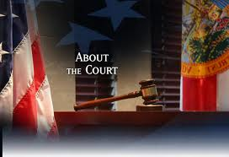
Part 1: Para. 2—4 (facts and quotes)
The background information about the trial, including the purpose of the trial, the law (Proposition 8) challenged in the trial, and the background of expert witness of the defendant.

Slide 26
Words and terms difficult to understand
P1: testify: to state or affirm under oath 作证
ban: a prohibition imposed by law or official decree. 禁令
P3: discredit: to cause to be doubted or distrusted. 使被怀疑

Slide 27
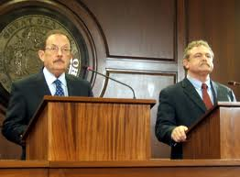
Part 2: Para. 5-7 (direct and indirect quotes)
The witness released the key statement that same-sex marriage would benefit the children under the cross-examination of the accuser’s lawyer.

Slide 28
Words:
P5: fare: To get along 进行
  P6: household: A domestic unit consisting of the members of a family who live together along with nonrelatives such as servants. 家庭

Slide 29
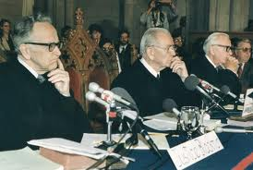
Part 3: Para.8-9 (facts and indirect quotes)
More background information about the trial (the significance of the trial, the time of it’s close and the judge of the trial)

Slide 30
Words:
  P8: wrap up: come to an end 结束 ，完成
  P9: hear: To listen to in an official, professional, or formal capacity 审理，听证
  testimony: A declaration by a witness under oath, as that given before a court. 证词

Slide 31
Para. 10-11 (opinions and direct quotes)
Further information about the witness’ related opinions about possible negative impact of homosexual marriage.

Slide 32
Words:
  P10: tenuous : thin 单薄的
  polygamy: the condition or practice of having more than one spouse at one time. 多配偶（制）

Slide 33
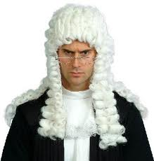
Para. 12-end (facts and direct quotes)
Minor details about the tense court debate between the witness and the accuser’s lawyer.

Slide 34
Words:
P12: nuanced:有细微差别的
P 13: snap : to utter abruptly or sharply 突然且严厉地说出
P 14: counter: to offer in response 反驳，回答

Slide 35
Result of the suit?
Guess?

Slide 36
Judge Overturns Gay Marriage Ban
1. Why were those voters who banned gay marriage wrong?
2. What makes the voters wrong according to Judge Walker?
3. How many states in US have approved same-sex marriage?
4. What are the reactions of proponents and opponents?

Slide 37
Good evening breaking news tonight in the America's national debate about what defines a family. Two years ago the voters of California banned gay marriage with 52% of the vote. This afternoon a federal judge said those voters were wrong. That banning gay marriage is fundamentally unconstitutional and violates America's commitment to end discrimination. A decision that will undoubtedly head to the Supreme Court and Terry Moran has been studying it all for us.

Slide 38
Federal judge Vaughn Walker ruling with sweeping and definitive striking down the ban on same-sex-marriage in ringing terms because California has no interest in discriminating against gay men and lesbians, the court concludes that Proposition 8 is unconstitutional. By striking down Proposition 8, judge Walker a republican appointee, declared that the 7 million Californians who voted for the ban got it wrong constitutionally.

Slide 39
Voters, he said, were driven by nothing more than a fear or unarticulated (不善表达的) dislike of same-sex couples, adding opposite-sex couples are not better than their same-sex counterparts instead, as partners, parents and citizens opposite-sex couples and same-sex couples are equal. Reaction was swift and intense from the Lesbian couple that brought the case, jubilation(欢呼).
“This decision says that we are Americans, too. We too should be treated equally.” (Plaintiff, Accuser, Claimant: Kristin Perry)

Slide 40
Their lawyers were a high-powered political-like couple. Democrat David Boies who represented Al Gore in the 2000 election dispute and Republican Ted Olson worked for George W. Bush in that case. But they found common ground in fighting for the rights of gays and lesbians.
“This is what American's justices all about.” (Co-Councilor Ted Olson )

Slide 41
On the other side, there was anger. And in this election year republican is seeing an opening.
Senator Jeff Sessions of Alabama blasted (=hit hard, criticize) the ruling: “This is an example of a judge feeling that they know better than their people what higher and better values are.”
Now the judge stayed his ruling from going into effect, so there will be no gay marriages in California just. Yeah, this case headed for an appeal （上诉）dying no question, all the way to the supreme court.

Slide 42
But I wanna show everybody the map right now, Terry, as if of tonight there are five states that have already approved same-sex marriage. They are Massachusetts, Connecticut, Iowa, New Hampshire, Vermont and, of course, Washington DC as well. So tell us what the courts have been saying about this nation-wide.

Slide 43
Well there's no question, Diane. this is a movement right now being driven in the courts and proponents say that that is where the courts' aware of our fundamental rights have always been advanced and protected. Opponents of same-sex marriage say this is just anti-democratic at the latest. And there is a risk of a backlash (集体反对), Diane, when the courts get too far ahead of the country. They risk their legitimacy, their authority. Right now, the country is divided on this,50 to 47 against same-sex marriage in the latest ABC news poll. It will be very interesting to see what happens to those numbers away...

Slide 44
But are you saying the courts have not ruled against (否决)it so far in states?
They have not. The Hawaii Supreme Court did dismiss a case that didn't rule our constitutionality. But right now it's a string of victories in the courts.

Slide 45
预告
第8周辩论：同性婚姻在中国是否应该合法化？
Should same-sex marriage be legalized in China?
Week 9： quiz 1（新闻相关知识10 个选择题; 词汇5 个独立句子，每个填一个单词,从10个选项选择；阅读一篇文章 5个选择题。）

Slide 46
Homework
Review unit 3 and finish Word Building on page 35. Refer to Vocabulary in Unit 3.
Read Further Reading on Page 39 in unit 3 and Supplementary Reading on Page 42, and finish the online reading homework. (第7周上课前完成，两周时间)
第三单元课后阅读问题作为阅读参考。

